Slide 1
🐍
Python
Data Cleaning and
Data Visualisation
3-Hour Complete Session | Google Colab | Real Dataset
🧹 Data Cleaning
📊 12 Chart Types
📁 Real Dataset
KAJOLA GBENGA ADEWALE
🔍 EDA
🎨 Seaborn
⚡ Plotly
Data Analytics Expert
Notes:
Opening slide for the 3-hour Python Data Cleaning and Visualisation session. Platform: Google Colab. Dataset: 4,500-row Nigerian retail sales dataset with intentional dirty data built in. By end of session students will have cleaned a real dataset and produced 12 different chart types.

Slide 2
SESSION OVERVIEW — 3 HOURS, TWO MAJOR PARTS
PART 1: Data Cleaning (90 min)
PART 2: Data Visualisation (90 min)
Section 01: Why clean data matters and the cost of dirty data
Section 07: Visualisation principles and chart selection guide
Section 02: Loading and inspecting the dataset in Colab
Section 08: Bar, Grouped Bar, and Stacked Bar charts
Section 03: Handling missing values (dropna, fillna)
Section 09: Line charts and Area charts
Section 04: Fixing data types (astype, to_datetime)
Section 10: Pie charts and Donut charts
Section 05: Removing duplicates and outliers
Section 11: Scatter plots, Histograms, and Box plots
Section 06: Validating and exporting clean data
Section 12: Heatmaps, Radar charts, and Dashboard layouts
Notes:
Session overview. Two equal halves of 90 minutes each. Tell students: the first half without clean data makes the second half's charts meaningless. Real analysts spend 60-80% of their time on cleaning. The visualisation half is the payoff for the cleaning work.

Slide 3
THE DATASET — NIGERIA RETAIL SALES (4,500 ROWS × 19 COLUMNS)
load_data.py
Column Guide
# Load the dataset in Colab
import pandas as pd
import numpy as np
df = pd.read_csv('nigeria_retail_sales.csv')
print(f'Shape: {df.shape}') # (4500, 19)
# First look
df.head()
df.tail()
df.sample(5) # random 5 rows
# Column overview
df.columns.tolist()
# ['order_id','date','month','quarter',
# 'product','category','region',
# 'sales_rep','channel','payment_mode',
# 'units','unit_cost','unit_price',
# 'discount_pct','revenue','profit',
# 'margin_pct','customer_rating','return_flag']
# Full summary
df.info() # column types and nulls
df.describe() # stats for numeric columns
order_id
str
ORD-010001
date
str→datetime
2023-03-15
product
str
Laptop Pro 15
category
str
Electronics
region
str
Lagos
units
int (has nulls)
5
unit_price
float (negatives)
450000.0
revenue
float
2250000.0
profit
float
625000.0
margin_pct
float
27.78
return_flag
str
Yes / No
Notes:
Dataset introduction. Upload nigeria_retail_sales.csv to Colab using the Files panel (left sidebar) or using the upload cell. The dataset has intentional dirty data: 190 rows with missing units, 89 with missing price, 44 with negative prices, 61 with zero units, inconsistent region values. Students will fix all of these.

Slide 4
01
Why Data Cleaning?
Garbage in — garbage out. No visualisation fixes bad data.

Slide 5
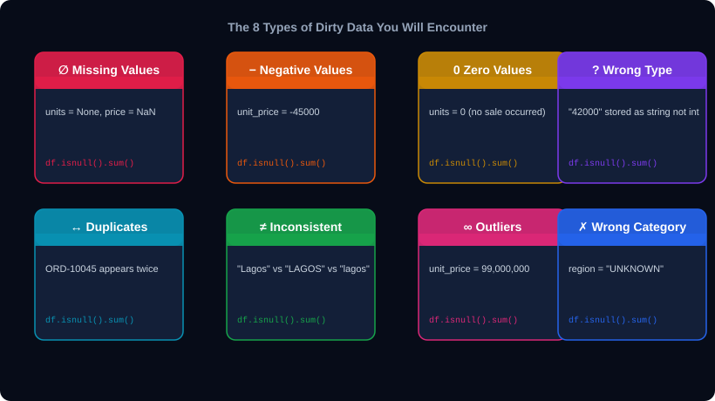
THE 8 TYPES OF DIRTY DATA YOU WILL ENCOUNTER
Notes:
The 8 dirty data types. Every type is present in our dataset. Walk through each one before students open their notebooks. The cost of not cleaning: a dashboard built on data with 4% negative prices will overstate costs; zero-unit rows inflate order counts; 'UNKNOWN' region breaks regional charts.

Slide 6
02
Inspect Before You Touch
Know exactly what you're dealing with.

Slide 7
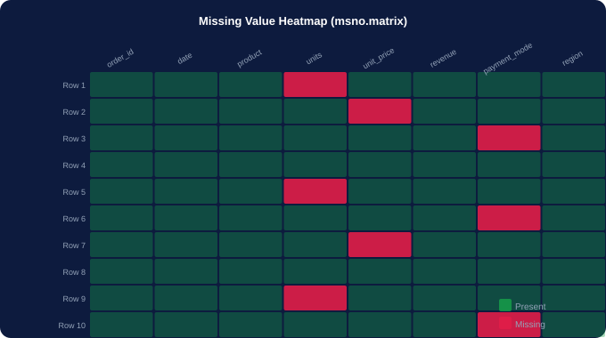
STEP 1: FULL DATASET INSPECTION
inspect.py
# ── SHAPE AND TYPES ──────────────────
df.shape # (4500, 19)
df.dtypes # column data types
df.info() # types + non-null counts
# ── MISSING VALUES ───────────────────
df.isnull().sum() # count per col
df.isnull().sum() / len(df) # % missing
df.isnull().any(axis=1).sum() # rows with any null
# ── NUMERIC SUMMARY ──────────────────
df.describe() # count,mean,std,min,quartiles,max
df.describe(include='all') # include strings too
# ── VALUE COUNTS ─────────────────────
df['category'].value_counts()
df['region'].value_counts() # spot 'UNKNOWN'
df['return_flag'].value_counts(normalize=True)
# ── DUPLICATES ───────────────────────
df.duplicated().sum() # total dupes
df[df.duplicated()] # view dupe rows
# ── VISUAL MISSING MAP ───────────────
import missingno as msno
msno.matrix(df) # heatmap of nulls
msno.bar(df) # bar chart of completeness
What to look for
Missing pattern (random vs systematic?), suspicious min/max values in describe(), unexpected categories in value_counts(), date columns stored as object dtype.
Notes:
Inspection is non-negotiable. Run all of these before touching a single row. Key insight from our dataset: df.describe() will show negative unit_price (min is negative — impossible), and zero units. value_counts() on region will reveal 'UNKNOWN'. This is the discovery phase.

Slide 8
03
Handling Missing Values
Every analyst's most common daily task.

Slide 9
STEP 2: HANDLE MISSING VALUES
missing.py
Rule 1: Assess before acting
# ── FIND THEM ────────────────────────
nulls = df.isnull().sum()
null_pct = (nulls / len(df) * 100).round(2)
print(null_pct[null_pct > 0])
# payment_mode 3.4%
# units 4.2%
# unit_price 2.0%
# ── OPTION 1: DROP ROWS ──────────────
df_drop = df.dropna() # drop any null row
df_drop2 = df.dropna(subset=['units','unit_price'])
# Use when: < 5% missing, rows are dispensable
# ── OPTION 2: FILL WITH CONSTANT ─────
df['payment_mode'].fillna('Unknown', inplace=True)
# Use when: category column, 'Unknown' is valid
# ── OPTION 3: FILL WITH STATISTIC ───
median_price = df['unit_price'].median()
df['unit_price'].fillna(median_price, inplace=True)
# Use median, not mean, if outliers present
# ── OPTION 4: FILL WITH GROUP MEDIAN ─
df['units'] = df.groupby('category')['units']\
.transform(lambda x: x.fillna(x.median()))
# Best: fills with category's own typical value
# ── VERIFY ───────────────────────────
df.isnull().sum() # should all be 0 now
Check the % missing first. Under 5%: drop or fill. 5-30%: fill with statistics. Over 30%: consider dropping the column entirely.
Rule 2: Mean vs Median
Use median for skewed data (prices, revenue). Use mean only if the distribution is symmetric. Our unit_price is right-skewed — use median.
Rule 3: Group-wise filling
Filling units with the overall median ignores the fact that Electronics and Grocery have very different typical order sizes. Group by category first.
Rule 4: Document decisions
Add a comment every time you fill or drop. Future-you needs to know why unit_price was filled with the category median, not the global median.
Rule 5: Never impute the target
In predictive models, never fill missing values in the column you're predicting. In EDA and visualisation, imputation is generally fine.
Notes:
Missing value handling. The group-wise median fill is the most professional approach and the most commonly used in data engineering. Demonstrate live: first fillna() with global median, then show how group transform gives better results. Verify with df.isnull().sum() at the end.

Slide 10
04
Fix Data Types and Invalid Values
Wrong types = silent errors in every calculation.

Slide 11
STEP 3: FIX TYPES, NEGATIVES, ZEROS, AND BAD CATEGORIES
fix_types.py
to_datetime() is essential
# ── CONVERT DATE COLUMN ──────────────
df['date'] = pd.to_datetime(df['date'])
df['year'] = df['date'].dt.year
df['month_num'] = df['date'].dt.month
df['day_of_week'] = df['date'].dt.day_name()
# ── FIX NEGATIVE PRICES ──────────────
neg_mask = df['unit_price'] < 0
print(f'Negative prices: {neg_mask.sum()}') # 44
df = df[~neg_mask] # remove rows with neg price
# OR: df.loc[neg_mask,'unit_price'] = df['unit_price'].abs()
# ── REMOVE ZERO-UNIT ROWS ────────────
df = df[df['units'] > 0]
print(f'Rows remaining: {len(df)}')
# ── FIX BAD REGION VALUES ────────────
df['region'].value_counts()
# 'UNKNOWN' appears — remove or map it
df = df[df['region'] != 'UNKNOWN']
# ── NORMALISE STRING COLUMNS ─────────
df['category'] = df['category'].str.strip().str.title()
df['region'] = df['region'].str.strip().str.title()
# ── RECOMPUTE DERIVED COLUMNS ────────
df['revenue'] = df['units'] * df['unit_price']
df['margin_pct'] = ((df['revenue']-df['units']*df['unit_cost'])
/ df['revenue'] * 100).round(2)
A date stored as a string cannot be filtered, sorted by month, or plotted on a time axis. Always convert with pd.to_datetime().
Removing vs correcting
Negative prices: remove the rows (only 44 of 4,500). If you had 1,000 negative prices, investigate — maybe there is a systematic data entry error.
.str.strip().str.title()
The two-method chain removes whitespace AND standardises case in one line. Apply to every string column used for grouping or filtering.
Recompute after fixing
Any column derived from a corrected column must be recomputed. Revenue = units * price. Fix price first, then recompute revenue.
Notes:
Type fixing. The to_datetime() conversion unlocks the entire time-series analysis: filtering by month, computing day-of-week patterns, resampling weekly/monthly. Without it, every time-based analysis fails silently. Demonstrate: before to_datetime(), df['date'].dt.month fails. After, it works instantly.

Slide 12
05
Duplicates and Outliers
The two issues most analysts miss until the chart looks wrong.

Slide 13
STEP 4: REMOVE DUPLICATES AND HANDLE OUTLIERS
outliers.py
IQR method: the standard
# ── DUPLICATES ───────────────────────
df.duplicated().sum() # count exact dupes
df.duplicated(subset=['order_id']).sum() # by ID
# Keep first occurrence, drop the rest
df = df.drop_duplicates(subset=['order_id'])
df = df.drop_duplicates() # exact row match
df.reset_index(drop=True, inplace=True)
print(f'Clean rows: {len(df)}')
# ── OUTLIER DETECTION: IQR METHOD ────
Q1 = df['revenue'].quantile(0.25)
Q3 = df['revenue'].quantile(0.75)
IQR = Q3 - Q1
lower = Q1 - 1.5 * IQR
upper = Q3 + 1.5 * IQR
outliers = df[(df['revenue']<lower)|(df['revenue']>upper)]
print(f'Outliers: {len(outliers)}')
# ── OUTLIER DETECTION: Z-SCORE ───────
from scipy import stats
z = np.abs(stats.zscore(df['revenue'].dropna()))
df_clean = df[z < 3] # keep within 3 std devs
# ── VISUALISE OUTLIERS ───────────────
import seaborn as sns, matplotlib.pyplot as plt
sns.boxplot(data=df, x='category', y='revenue')
plt.xticks(rotation=45)
plt.show()
The Tukey fence rule (Q1-1.5×IQR, Q3+1.5×IQR) is used in box plots and is the most interpretable outlier rule. Use it first.
Z-score: for normal distributions
Z > 3 means more than 3 standard deviations from the mean. Only works well when data is approximately normally distributed.
Remove vs cap
Removing outliers is risky. Capping (winsorising) keeps the row but limits extreme values: df['revenue'].clip(lower, upper). Preferred in financial data.
Investigate before removing
An order of 200 laptops might look like an outlier but could be a legitimate B2B sale. Always understand why a value is extreme before deleting it.
Notes:
Duplicates and outliers. The IQR method is the most commonly used and produces the same outlier bounds that box plots visually show. Run the box plot command and show students that the dots beyond the whiskers are exactly what the IQR formula flagged. This visual-statistical connection is powerful.

Slide 14
06
Validate and Export
Prove the data is clean before you chart a single thing.

Slide 15
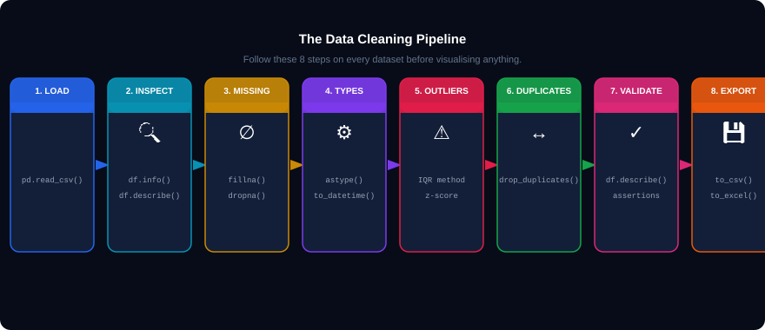
THE COMPLETE CLEANING PIPELINE
export.py
df.to_csv('nigeria_retail_clean.csv', index=False) # save clean version
print(f'Final clean dataset: {df.shape[0]:,} rows, {df.shape[1]} columns') # verify before charting
Notes:
The 8-step pipeline is the professional workflow. Run the final assertion block that checks zero nulls, no negatives, no unknown regions, correct types — before exporting. Save the clean CSV so the visualisation session can start fresh without re-running the cleaning.

Slide 16
07
Visualisation Principles
The chart must communicate, not just exist.

Slide 17
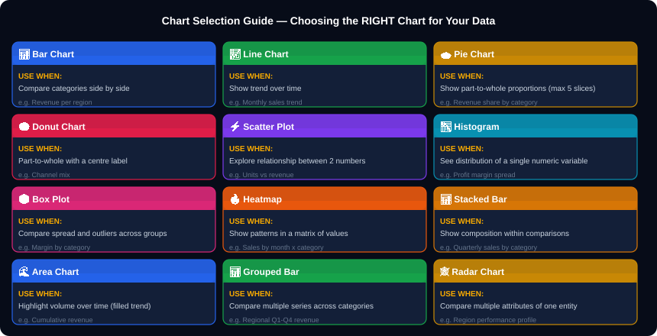
THE CHART SELECTION GUIDE — CHOOSE THE RIGHT CHART
Notes:
The chart selection guide is the single most important reference in the visualisation half. Every time a student wants to make a chart, they should ask: WHY does this chart type fit this data? Print this slide. Walk through each chart, its when-to-use, and the business example. This prevents the most common mistake: using pie charts for 8 categories or line charts for nominal data.

Slide 18
SETTING UP YOUR VISUALISATION ENVIRONMENT IN COLAB
setup_viz.py
# ── ALL IMPORTS — Run this cell first ──────────────────────────────────────────
import pandas as pd
import numpy as np
import matplotlib.pyplot as plt
import matplotlib.ticker as mticker
import seaborn as sns
import plotly.express as px
import plotly.graph_objects as go
from plotly.subplots import make_subplots
# ── GLOBAL STYLE SETTINGS ──────────────────────────────────────────────────────
plt.style.use('seaborn-v0_8-darkgrid') # clean professional theme
sns.set_theme(style='darkgrid', palette='tab10')
plt.rcParams.update({'figure.figsize':(12,6), 'font.size':12,
'axes.titlesize':14, 'axes.titleweight':'bold'})
# ── LOAD CLEAN DATASET ─────────────────────────────────────────────────────────
df = pd.read_csv('nigeria_retail_clean.csv')
df['date'] = pd.to_datetime(df['date'])
print(f'Ready: {df.shape[0]:,} clean rows loaded.')
# ── COLOUR PALETTE ─────────────────────────────────────────────────────────────
PALETTE = ['#2563EB','#16A34A','#CA8A04','#E11D48','#7C3AED']
CAT_COLORS = {'Electronics':'#2563EB','Groceries':'#16A34A',
'Furniture':'#CA8A04','Health':'#E11D48','Stationery':'#7C3AED'}
plt.style.use()
rcParams.update()
Three libraries, three strengths
Pick once, applies to all subsequent charts. 'seaborn-v0_8-darkgrid' is the most popular for data analysis.
Set default figure size and font size globally. No need to specify them on every chart.
Matplotlib: full control, publication-quality. Seaborn: statistical charts in one line. Plotly: interactive HTML charts.
Notes:
Setup cell. Run this once at the start of every visualisation session. Setting rcParams globally saves re-specifying figure size on every chart. Having a consistent palette makes dashboards look professional. Plotly charts are interactive in Colab — students can hover over data points.

Slide 19
08
Bar, Grouped Bar, and Stacked Bar
Comparing things. The most used charts in business.

Slide 20
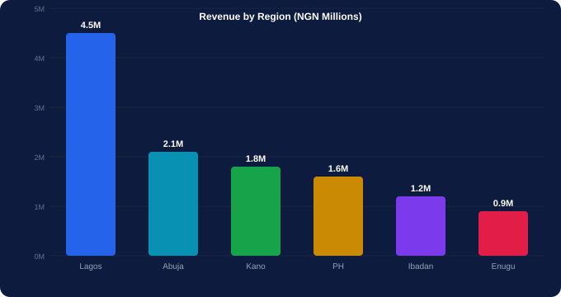
BAR CHART — WHEN AND HOW
bar_chart.py
# ── WHY BAR CHART? ───────────────────
# Compare DISCRETE categories side by side.
# Best for: regional comparison, product ranking,
# channel performance, top-N lists.
# ── MATPLOTLIB BAR ───────────────────
rev_by_region = (df.groupby('region')['revenue']
.sum().sort_values(ascending=False))
fig, ax = plt.subplots(figsize=(12,6))
colors = plt.cm.Blues_r(np.linspace(0.3,0.9,len(rev_by_region)))
bars = ax.bar(rev_by_region.index,
rev_by_region.values/1e6,
color=colors, edgecolor='white')
ax.bar_label(bars, fmt='NGN %.1fM', padding=4)
ax.set_title('Revenue by Region', fontsize=16, fontweight='bold')
ax.set_ylabel('Revenue (NGN Millions)')
plt.tight_layout(); plt.show()
bar_seaborn.py
# ── SEABORN BAR (EASIER) ─────────────
sns.barplot(data=df, x='region', y='revenue',
estimator=sum,
order=rev_by_region.index,
palette='Blues_r')
plt.title('Revenue by Region'); plt.show()
WHY USE A BAR CHART?
• Compare revenue across 8 regions instantly
• Rank products or reps from highest to lowest
• Show monthly targets vs actuals
• NOT for: time series (use line), proportions (use pie)
Notes:
Bar chart. The sort_values(ascending=False) is critical — always sort before plotting so the audience's eye naturally reads from most to least important. bar_label() adds value labels on top of each bar — a professional touch that removes the need to squint at the Y axis.

Slide 21
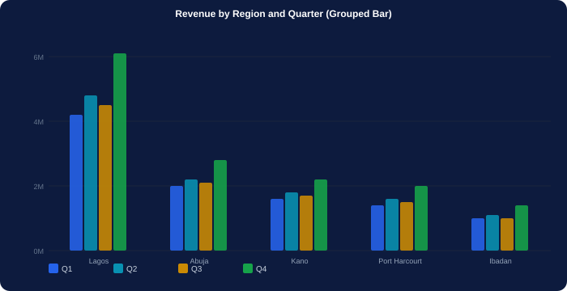
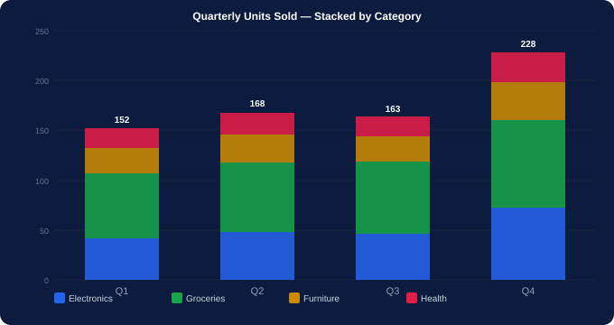
GROUPED BAR AND STACKED BAR — COMPARING MULTIPLE SERIES
grouped.py
stacked.py
# Grouped Bar — compare quarters per region
df_pivot = df.pivot_table(index='region',columns='quarter',
values='revenue',aggfunc='sum')/1e6
df_pivot.plot(kind='bar',figsize=(12,6),colormap='Set2')
plt.title('Revenue by Region and Quarter'); plt.show()
# Stacked Bar — category contribution per quarter
df_stack = df.pivot_table(index='quarter',
columns='category',
values='units',aggfunc='sum')
df_stack.plot(kind='bar',stacked=True,figsize=(10,6))
plt.title('Units by Quarter — Stacked'); plt.show()
GROUPED: compare absolute values across groups | STACKED: show composition — what portion each part contributes to the total
Notes:
Grouped vs Stacked. Key rule: grouped bar is better when you need to compare the same category across groups. Stacked is better when you want to see both the total and the composition. Never use 100% stacked bar when the absolute totals matter — it hides size differences.

Slide 22
09
Line Charts and Area Charts
Time is on the X axis. Story is in the slope.

Slide 23
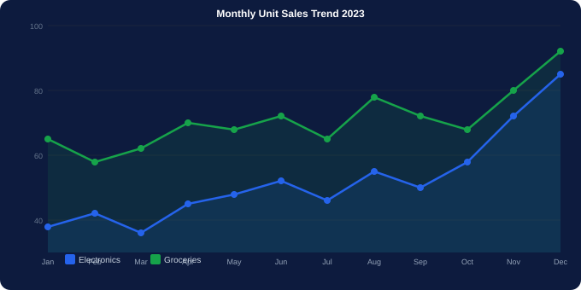
LINE CHART — TRENDS OVER TIME
line_chart.py
# ── LINE CHART ───────────────────────
monthly = (df.groupby(['month_num','category'])
['revenue'].sum().unstack() / 1e6)
fig, ax = plt.subplots(figsize=(13,6))
for cat in monthly.columns:
ax.plot(monthly.index, monthly[cat],
marker='o', linewidth=2.5,
label=cat)
ax.set_xticks(range(1,13))
ax.set_xticklabels(['Jan','Feb','Mar','Apr','May','Jun',
'Jul','Aug','Sep','Oct','Nov','Dec'])
ax.set_title('Monthly Revenue Trend by Category')
ax.set_ylabel('Revenue (NGN Millions)')
ax.legend(loc='upper left')
ax.yaxis.set_major_formatter(
mticker.FuncFormatter(lambda x,_: f'NGN{x:.0f}M'))
# Annotate peak month
peak_month = monthly.sum(axis=1).idxmax()
peak_val = monthly.sum(axis=1).max()
ax.annotate(f'Peak: NGN{peak_val:.1f}M',
xy=(peak_month, peak_val),
xytext=(peak_month-1, peak_val+0.5),
arrowprops=dict(arrowstyle='->'))
plt.tight_layout(); plt.show()
# WHY: X axis = time, Y axis = measured value.
# Best for: trend, growth, seasonality, comparison over time.
# NOT for: comparing discrete unordered categories.
Notes:
Line chart. The annotate() call adds a professional arrow annotation pointing to the peak month — a critical storytelling skill. The FuncFormatter for the Y axis labels (NGN20M instead of 20000000) is the single change that most improves readability in financial charts.

Slide 24
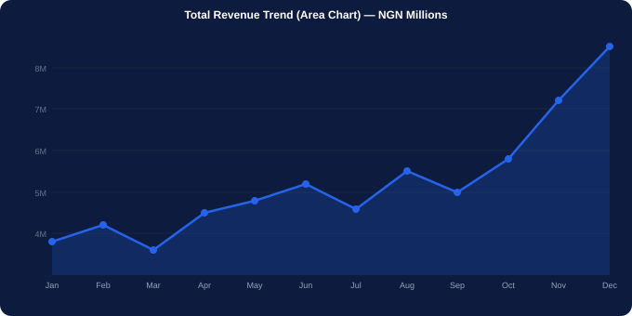
AREA CHART — CUMULATIVE VOLUME AND FILLED TRENDS
area_chart.py
# ── AREA CHART (Matplotlib) ──────────
monthly_total = df.groupby('month_num')['revenue'].sum()/1e6
fig, ax = plt.subplots(figsize=(13,6))
ax.fill_between(monthly_total.index, monthly_total,
alpha=0.25, color='#2563EB')
ax.plot(monthly_total.index, monthly_total,
color='#2563EB', linewidth=2.5, marker='o')
plt.title('Monthly Revenue — Area Chart'); plt.show()
area_plotly.py
# ── STACKED AREA (Plotly) ────────────
monthly_cat = (df.groupby(['month_num','category'])
['revenue'].sum().reset_index())
fig = px.area(monthly_cat, x='month_num',
y='revenue', color='category',
title='Monthly Revenue by Category')
fig.update_layout(hovermode='x unified')
fig.show() # interactive in Colab!
# WHY AREA CHART?
# Same as line but filled below the line.
# Use when: emphasising VOLUME, comparing contributions,
# or showing cumulative growth over time.
Notes:
Area chart. The key difference from line: area charts emphasise the volume under the curve. Stacked area charts show both total and composition simultaneously. The Plotly version adds hover interactivity — when you hover, it shows all category values for that month simultaneously.

Slide 25
10
Pie Charts and Donut Charts
Parts of a whole — used sparingly and correctly.

Slide 26
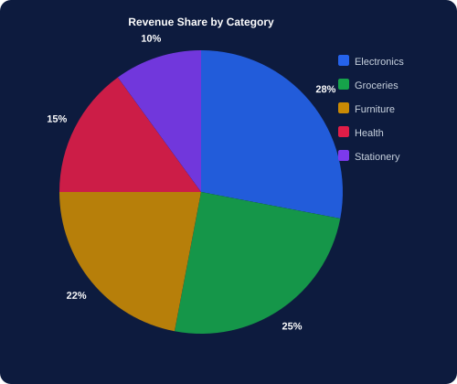
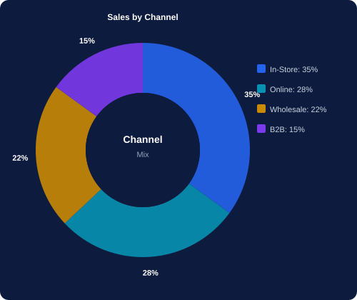
PIE CHART AND DONUT CHART — PARTS OF A WHOLE
pie_chart.py
# PIE — only max 5-6 slices
cat_rev = df.groupby('category')['revenue'].sum()
fig, ax = plt.subplots(figsize=(8,8))
wedges, texts, autos = ax.pie(
cat_rev, labels=cat_rev.index,
autopct='%1.1f%%',
colors=PALETTE, startangle=90,
pctdistance=0.85)
ax.set_title('Revenue Share by Category')
plt.show()
donut_chart.py
# DONUT — add a hole in the centre
chan_rev = df.groupby('channel')['revenue'].sum()
wedges,_,_ = ax.pie(
chan_rev, labels=None,
autopct='%1.0f%%',
wedgeprops={'width':0.55}) # makes donut
ax.text(0,0,'Channel\nMix',ha='center',
va='center', fontsize=12)
plt.show()
WHY PIE/DONUT? — AND WHEN NOT TO USE THEM
USE: 5 or fewer slices, clear dominant segment, part-to-whole story (market share, budget allocation, channel mix). AVOID: many slices, comparing similar sizes, time series. Rule: if you need to label every slice, use a bar chart instead.
Notes:
Pie charts are the most misused chart in business. The rule: if any two slices look the same size, switch to a bar chart so the audience can compare. Donut adds a label space in the centre. Both are best for 3-5 slices with one clearly dominant segment.

Slide 27
11
Scatter, Histogram, and Box Plot
Reveal relationships, distributions, and spread.

Slide 28
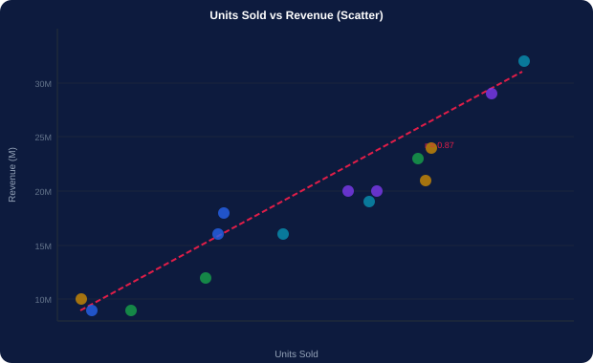
SCATTER PLOT — RELATIONSHIPS BETWEEN TWO NUMERIC VARIABLES
scatter_chart.py
# ── SCATTER PLOT ─────────────────────
fig, ax = plt.subplots(figsize=(11,7))
for cat, grp in df.groupby('category'):
ax.scatter(grp['units'], grp['revenue']/1e3,
label=cat, alpha=0.5, s=40)
# Add trend line
z = np.polyfit(df['units'], df['revenue']/1e3, 1)
p = np.poly1d(z)
ax.plot(sorted(df['units']),
p(sorted(df['units'])),
'r--', linewidth=2, label='Trend')
ax.set_xlabel('Units Sold')
ax.set_ylabel('Revenue (NGN Thousands)')
ax.set_title('Units Sold vs Revenue by Category')
ax.legend()
# Print correlation coefficient
r = df['units'].corr(df['revenue'])
ax.text(0.05,0.95,f'r = {r:.3f}',
transform=ax.transAxes,
bbox=dict(boxstyle='round',facecolor='yellow',alpha=0.3))
# Plotly interactive version
fig2 = px.scatter(df, x='units', y='revenue',
color='category', hover_name='product',
trendline='ols')
fig2.show() # hover over any dot!
# WHY: reveals correlation, clusters, outliers.
# Best for: units vs revenue, price vs margin, experience vs rating.
# NOT for: categorical X axis or time series.
Notes:
Scatter plot. The correlation coefficient r (printed on the chart) adds quantitative backing to the visual pattern. r > 0.7 is strong positive. r < -0.7 is strong negative. r near 0 means no linear relationship. The Plotly version with trendline='ols' fits an OLS regression line automatically and shows R² on hover.

Slide 29
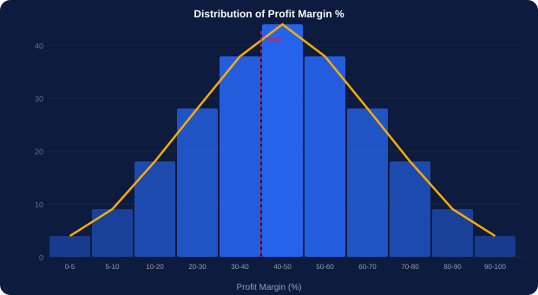
HISTOGRAM — DISTRIBUTION OF A SINGLE NUMERIC VARIABLE
histogram.py
# ── HISTOGRAM (Matplotlib) ───────────
fig, ax = plt.subplots(figsize=(11,6))
ax.hist(df['margin_pct'].dropna(), bins=40,
color='#2563EB', edgecolor='white',
alpha=0.85)
# Add mean and median lines
mean_val = df['margin_pct'].mean()
median_val = df['margin_pct'].median()
ax.axvline(mean_val, color='#E11D48',
linestyle='--', label=f'Mean {mean_val:.1f}%')
ax.axvline(median_val, color='#F9AB00',
linestyle=':', label=f'Median {median_val:.1f}%')
ax.set_xlabel('Profit Margin (%)')
ax.set_ylabel('Number of Transactions')
ax.set_title('Distribution of Profit Margin')
ax.legend()
# ── SEABORN WITH KDE OVERLAY ─────────
fig, ax = plt.subplots(figsize=(11,6))
sns.histplot(data=df, x='margin_pct', bins=40,
kde=True, color='#2563EB')
# ── PLOTLY INTERACTIVE ───────────────
fig = px.histogram(df, x='margin_pct',
color='category',
barmode='overlay', opacity=0.7,
title='Margin Distribution')
fig.show()
# WHY: see the SHAPE of data — normal, skewed, bimodal?
# Best for: margin %, price, age, salary distributions.
# NOT for: categorical data or time series.
Notes:
Histogram. The most important thing to read from a histogram: is the distribution normal, right-skewed, left-skewed, or bimodal? Right-skewed margin distribution (long tail right) means most transactions are low-margin with a few very high-margin outliers. Adding mean AND median lines reveals skewness: if mean > median, the data is right-skewed.

Slide 30
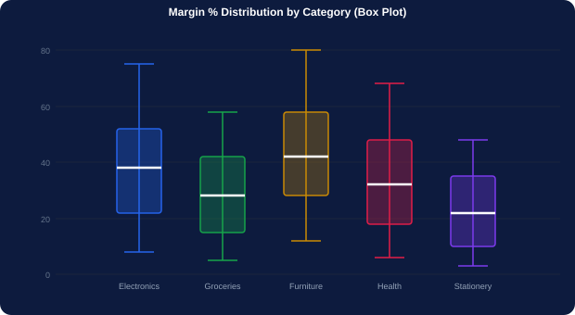
BOX PLOT — SPREAD, QUARTILES, AND OUTLIERS AT A GLANCE
box_plot.py
# ── BOX PLOT (Seaborn) ───────────────
fig, ax = plt.subplots(figsize=(13,7))
sns.boxplot(data=df, x='category',
y='margin_pct',
palette=CAT_COLORS,
width=0.5,
flierprops={'marker':'o',
'color':'red',
'markersize':5})
ax.set_title('Profit Margin Distribution by Category')
ax.set_xlabel('Category')
ax.set_ylabel('Margin %')
ax.axhline(df['margin_pct'].median(),
color='red', linestyle='--',
label='Overall Median')
ax.legend(); plt.show()
# ── VIOLIN PLOT (richer version) ─────
sns.violinplot(data=df, x='category',
y='margin_pct',
palette=CAT_COLORS)
plt.show()
# WHY: 5 statistics in one visual (min,Q1,median,Q3,max).
# Best for: comparing spread across groups, spotting outliers.
# Dots beyond whiskers = outliers (beyond 1.5×IQR).
Box plot anatomy: bottom whisker=min non-outlier • Q1=25th pct • median line=50th pct • Q3=75th pct • top whisker=max non-outlier • dots=outliers
Notes:
Box plot. The violin plot is the box plot's sibling — it adds a kernel density curve showing exactly where the data is concentrated. Groceries may have a wide box (high variance between transactions) while Stationery has a narrow box (consistent margins). The axhline showing the overall median gives a reference line for comparison.

Slide 31
12
Heatmaps, Radar Charts, and Dashboards
Pattern detection, profiling, and multi-chart layouts.

Slide 32
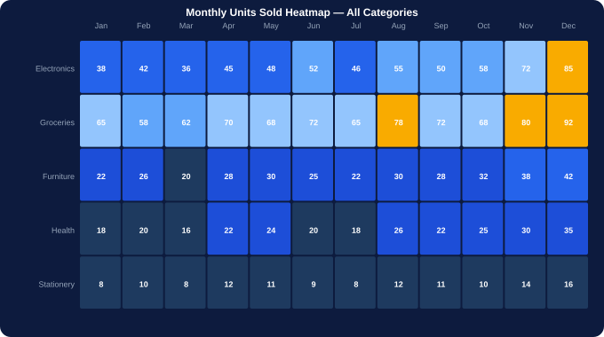
HEATMAP — MATRIX OF VALUES AS A COLOUR GRID
heatmap.py
# ── HEATMAP (Seaborn) ────────────────
heat_data = df.pivot_table(
index='category',
columns='month',
values='revenue',
aggfunc='sum') / 1e6
# Reorder months chronologically
month_order = ['Jan','Feb','Mar','Apr','May','Jun',
'Jul','Aug','Sep','Oct','Nov','Dec']
heat_data = heat_data[month_order]
fig, ax = plt.subplots(figsize=(14,5))
sns.heatmap(heat_data, annot=True,
fmt='.1f',
cmap='Blues',
linewidths=0.5,
cbar_kws={'label':'NGN M'},
ax=ax)
ax.set_title('Revenue Heatmap — Category x Month')
plt.tight_layout(); plt.show()
# ── CORRELATION HEATMAP ──────────────
num_cols = ['units','unit_price','revenue','profit','margin_pct']
corr = df[num_cols].corr()
sns.heatmap(corr, annot=True, fmt='.2f',
cmap='coolwarm', center=0,
square=True)
plt.title('Correlation Matrix'); plt.show()
# WHY: spot patterns in month×category or correlation matrix.
# Best for: seasonality, cross-tab analysis, correlation.
Notes:
Heatmap. Two variants: the cross-tab heatmap (revenue by category and month) reveals seasonality patterns — Electronics peaks in November-December (Black Friday / Christmas season). The correlation heatmap shows which numeric variables move together — crucial before building any model or interpretation.

Slide 33
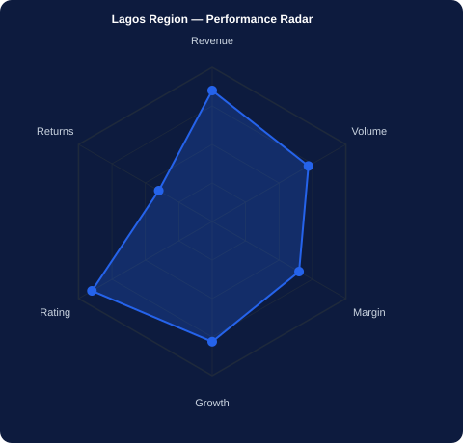
RADAR CHART — MULTI-ATTRIBUTE PROFILE IN ONE VISUAL
radar_chart.py
# WHY: compare an entity across multiple dimensions.
# Best for: comparing regions/products on 4-8 metrics.
# NOT for: too many spokes (>10) — gets unreadable.
import plotly.graph_objects as go
# Build per-region metrics
regions_metrics = df.groupby('region').agg(
revenue = ('revenue','sum'),
volume = ('units','sum'),
margin = ('margin_pct','mean'),
rating = ('customer_rating','mean'),
orders = ('order_id','count'),
).reset_index()
# Normalise 0-100 for radar
for col in ['revenue','volume','margin','rating','orders']:
mn = regions_metrics[col].min()
mx = regions_metrics[col].max()
regions_metrics[col+'_n'] = (
(regions_metrics[col]-mn)/(mx-mn)*100)
categories = ['Revenue','Volume','Margin','Rating','Orders']
fig = go.Figure()
for _, row in regions_metrics.iterrows():
vals = [row[c+'_n'] for c in
['revenue','volume','margin','rating','orders']]
fig.add_trace(go.Scatterpolar(
r=vals+[vals[0]], theta=categories+[categories[0]],
name=row['region'], fill='toself', opacity=0.3))
fig.update_layout(title='Region Performance Radar')
fig.show()
Notes:
Radar chart. The normalisation step (0-100 per metric) is essential — without it, revenue (millions) would dominate the chart and all other spokes would be invisible. Plotly's interactive radar lets students hover on each spoke to see exact values. Used heavily in performance management and sales territory analysis.

Slide 34
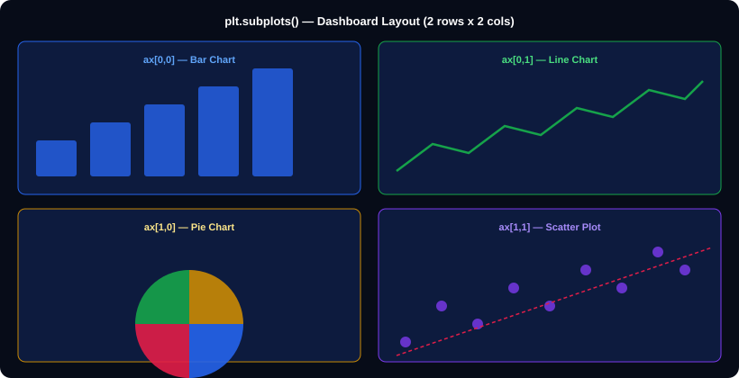
BUILDING A MULTI-CHART DASHBOARD WITH plt.subplots()
dashboard.py
# 2×2 dashboard layout
fig, axes = plt.subplots(2, 2,
figsize=(16, 10))
fig.suptitle('Nigeria Retail Sales Dashboard',
fontsize=18, fontweight='bold')
# Top-left: bar chart
rev_r = df.groupby('region')['revenue'].sum()/1e6
axes[0,0].bar(rev_r.index, rev_r.values)
axes[0,0].set_title('Revenue by Region')
# Top-right: line chart
monthly = df.groupby('month_num')['revenue'].sum()/1e6
axes[0,1].plot(monthly.index, monthly.values,'o-')
axes[0,1].set_title('Monthly Revenue Trend')
# Bottom-left: pie chart
cat_r = df.groupby('category')['revenue'].sum()
axes[1,0].pie(cat_r, labels=cat_r.index, autopct='%1.0f%%')
axes[1,0].set_title('Revenue by Category')
# Bottom-right: scatter
axes[1,1].scatter(df['units'],df['revenue']/1e3,alpha=0.3)
axes[1,1].set_title('Units vs Revenue')
plt.tight_layout(rect=[0,0,1,0.95])
plt.savefig('dashboard.png', dpi=150,
bbox_inches='tight')
plt.show()
plotly_dash.py
# Full Plotly dashboard
from plotly.subplots import make_subplots
fig = make_subplots(rows=2, cols=2,
subplot_titles=['By Region','Trend','Category','Units vs Rev'])
# ...add traces with row=1/2, col=1/2...
fig.show() # one interactive HTML page!
Notes:
Dashboard layout. plt.subplots(rows,cols) is how professional analysts combine charts into a single figure. fig.suptitle() adds an overall dashboard title. tight_layout() prevents charts from overlapping. plt.savefig() exports a publication-quality PNG. The Plotly make_subplots creates an interactive HTML dashboard.

Slide 35
SEABORN PAIRPLOT — EDA IN ONE LINE
pairplot.py
# sns.pairplot() creates a grid of scatter plots for every pair of numeric columns
# — plus histograms on the diagonal. Most powerful one-liner in EDA.
cols_to_plot = ['units', 'unit_price', 'revenue', 'profit', 'margin_pct', 'customer_rating']
sns.pairplot(df[cols_to_plot + ['category']],
hue='category', # colour each category differently
vars=cols_to_plot, # only numeric columns
plot_kws={'alpha':0.4, 's':20}, # semi-transparent small dots
diag_kind='kde', # kernel density on diagonal instead of histogram
corner=False) # show full grid (not just lower triangle)
plt.suptitle('Pairplot — Nigeria Retail Numeric Variables by Category', y=1.02)
plt.savefig('pairplot.png', dpi=120, bbox_inches='tight')
plt.show() # takes ~10 seconds to render in Colab — wait for it!
Why pairplot?
What to look for
Performance note
Every scatter and every distribution in one command. Use at the start of EDA to see all relationships simultaneously. Look for: diagonal patterns (strong correlation), separated colour clusters (category differences), unusual shapes (bimodal distributions, outlier islands).
Revenue vs units: strong diagonal (expected). Margin vs price: scattered (price alone doesn't determine margin). Rating vs anything: weak correlation (product quality is independent of category sales performance).
With 4,500 rows × 6 variables, pairplot draws 30 scatter plots. It takes ~15-20 seconds in Colab. Tell students to run it and wait — do not double-click the cell. Save the output as a PNG for quick reference.
Notes:
Pairplot is the most productive single command in EDA. It is the first chart a data scientist runs on a new dataset. The hue='category' parameter colours points by category — immediately reveals whether different categories have different price points, volumes, and margins.

Slide 36
FINAL
Full End-to-End Project
Load → Clean → Visualise → Present.

Slide 37
THE END-TO-END NOTEBOOK — ALL IN ONE COLAB CELL SEQUENCE
full_project.py
# ═══ CELL 1: IMPORTS ══════════════════════════════════════════════════════════
import pandas as pd, numpy as np
import matplotlib.pyplot as plt, seaborn as sns
import plotly.express as px
plt.style.use('seaborn-v0_8-darkgrid')
# ═══ CELL 2: LOAD ═════════════════════════════════════════════════════════════
df = pd.read_csv('nigeria_retail_sales.csv')
print(df.shape) # (4500, 19)
# ═══ CELL 3: INSPECT ══════════════════════════════════════════════════════════
print(df.isnull().sum()[df.isnull().sum()>0]) # find nulls
print(df['region'].value_counts()) # spot UNKNOWN
# ═══ CELL 4: CLEAN ════════════════════════════════════════════════════════════
df['unit_price'] = df.groupby('category')['unit_price'].transform(lambda x: x.fillna(x.median()))
df['units'] = df.groupby('category')['units'].transform(lambda x: x.fillna(x.median()))
df['payment_mode'].fillna('Unknown', inplace=True)
df = df[df['unit_price'] > 0] # remove negatives
df = df[df['units'] > 0] # remove zeros
df = df[df['region'] != 'UNKNOWN'] # remove bad region
df['date'] = pd.to_datetime(df['date'])
df['month_num'] = df['date'].dt.month
df['category'] = df['category'].str.strip().str.title()
df['revenue'] = df['units'] * df['unit_price']
print(f'Clean shape: {df.shape}')
# ═══ CELL 5: VISUALISE — run each sub-cell independently ═══════════════════
# ── 5a. Revenue by region (bar) ──
df.groupby('region')['revenue'].sum().sort_values(ascending=False).plot(kind='bar',color='#2563EB')
plt.title('Revenue by Region'); plt.tight_layout(); plt.show()
# ── 5b. Monthly trend (line) ─────
df.groupby('month_num')['revenue'].sum().plot(kind='line',marker='o',color='#16A34A')
plt.title('Monthly Revenue Trend'); plt.show()
# ── 5c. Category share (pie) ─────
df.groupby('category')['revenue'].sum().plot(kind='pie',autopct='%1.1f%%',startangle=90)
plt.title('Revenue by Category'); plt.ylabel(''); plt.show()
# ── 5d. Margin distribution (hist) ──
sns.histplot(df['margin_pct'], bins=40, kde=True, color='#7C3AED')
plt.title('Profit Margin Distribution'); plt.show()
# ── 5e. Correlation heatmap ──────
sns.heatmap(df[['units','unit_price','revenue','profit','margin_pct']].corr(),annot=True,fmt='.2f',cmap='Blues')
plt.title('Correlation Matrix'); plt.show()
Notes:
Full end-to-end notebook. Run each CELL block sequentially. The cleaning pipeline in Cell 4 runs in under 5 seconds on the full 4,500-row dataset. Visualisation cells each run in 2-4 seconds. By the end students have a complete, professional analysis of the Nigerian retail dataset.

Slide 38
QUICK REFERENCE — DATA CLEANING AND VISUALISATION CHEAT SHEET
Load and inspect
Handle missing
Fix types
pd.read_csv() df.info() df.describe()
df.isnull().sum() df.duplicated().sum()
df.fillna(value) df.dropna(subset=[])
df.groupby(col)[col2].transform('median')
pd.to_datetime() .astype('float')
.str.strip().str.title() .str.replace()
Filter bad data
Outliers
Aggregation
df[df['col'] > 0]
df[df['col'].isin(valid_list)]
Q1=.quantile(0.25) Q3=.quantile(0.75)
df[(df>Q1-1.5*(Q3-Q1))&(df<Q3+1.5*(Q3-Q1))]
df.groupby(col)[col2].sum()
df.pivot_table(index,columns,values,aggfunc)
Matplotlib
Seaborn
Plotly
plt.subplots() ax.bar() ax.plot()
ax.scatter() ax.hist() ax.set_title()
sns.barplot() sns.lineplot() sns.boxplot()
sns.heatmap() sns.histplot(kde=True)
px.bar() px.line() px.pie() px.scatter()
px.area() px.histogram() fig.show()
Chart guide
Chart guide 2
Style
Compare categories → Bar
Trend over time → Line
Proportion → Pie/Donut
Relationship → Scatter
Distribution → Histogram
Spread + outliers → Box
plt.style.use('seaborn-v0_8-darkgrid')
plt.rcParams.update({'figure.figsize':(12,6)})
Notes:
Cheat sheet. Print and distribute to every student at the end of session.

Slide 39
🐍
Python Data Cleaning
and Visualisation
3-Hour Session Complete
What you completed today:
🧹 Loaded and fully cleaned a 4,500-row real dataset
🔍 Handled missing values, negatives, duplicates, outliers
📊 Built 12 different chart types with real business data
🎨 Used Matplotlib, Seaborn, and Plotly
You can now clean any dataset
and tell its story with 12 chart types.
📐 Applied correct chart selection principles
📁 Built and saved a multi-chart dashboard
Kajola Gbenga Adewale
Data Analytics Expert
Next: pandas advanced (groupby, merge, reshape) → then Machine Learning with Scikit-Learn.
Notes:
Closing slide. Students have done a complete, professional data analysis: loaded → inspected → cleaned → visualised → presented. The next session naturally flows into advanced Pandas (groupby, merge, pivot) and then Scikit-Learn for predictive analytics.

